Slide 1

SAP Build Apps & Build Code
Deloitte Consulting LLP
Notes:
A basic Operate/AMS presentation to take clients through our thoughts on operate.
Owner: TBD
Last Updated: 02/09/2018
Change log
V1.0
Color palette updated.
Fonts adjusted and resized.
Inverter test completed.
Cover image made transparent.
New text & Shape test passed.
Speaker notes reviewed and cleansed.

Slide 2
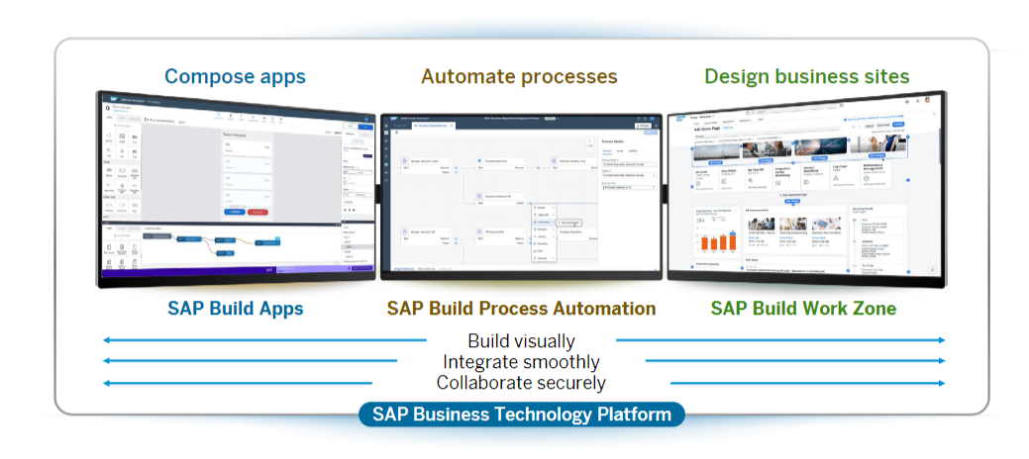
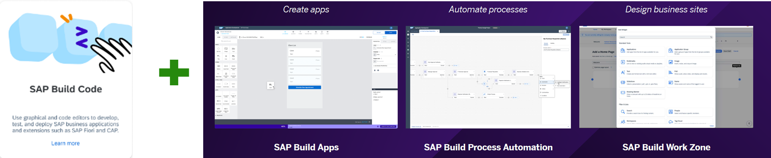
SAP Build Portfolio

Slide 3
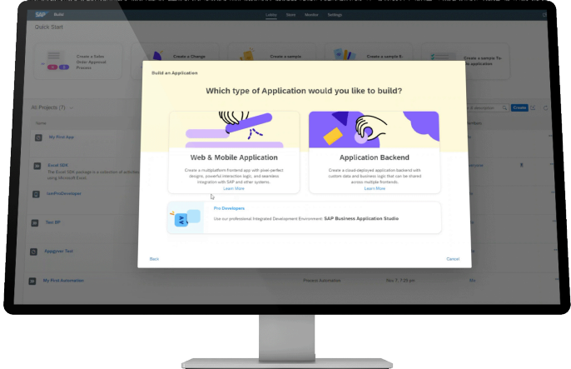
SAP Build Apps Features
01
Create Apps without code
02
Build Simpler and Faster
03
Integrate Seamlessly
04
Collaboration and Governance
05
Pre delivered templates & logic components
06
Develop and Extend web & mobile applications

Slide 4
SAP Build Apps Insights
Pros
Low code/no code development to create apps with minimal or no coding required
Offers User friendly interface to create prototypes without extensive technical knowledge
Available in Trial Account
Limitations
Offers limited customization and well suited for simple to medium complexity developments
For small & medium sized enterprises, cost needs to be well assessed & weighed
A bit learning curve might be needed for those who are not familiar with SAP products
SAP Build Apps

Slide 5
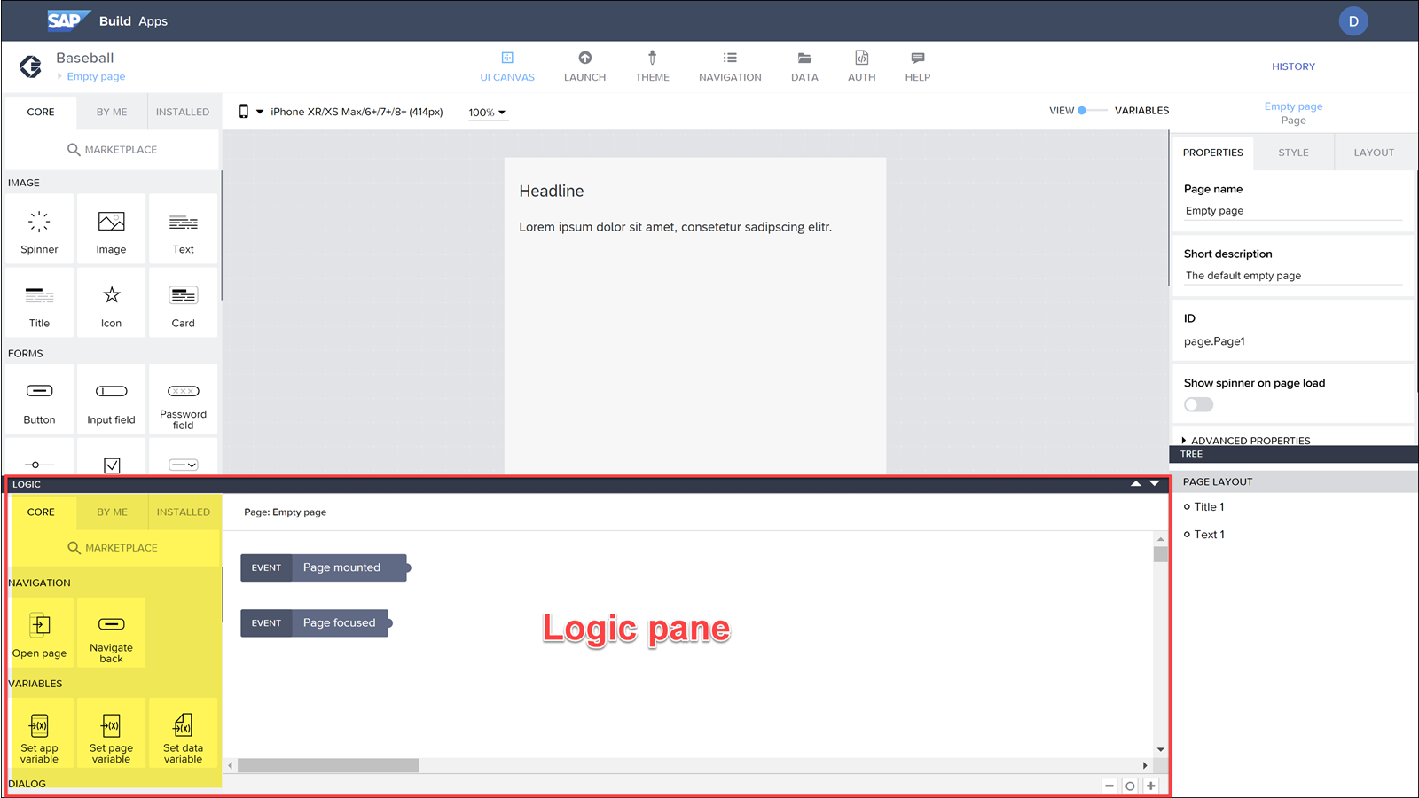
SAP Build Apps
Create a new project from Build Lobby and launch SAP Build Apps
Notes:
What to expect from Joule

Slide 6
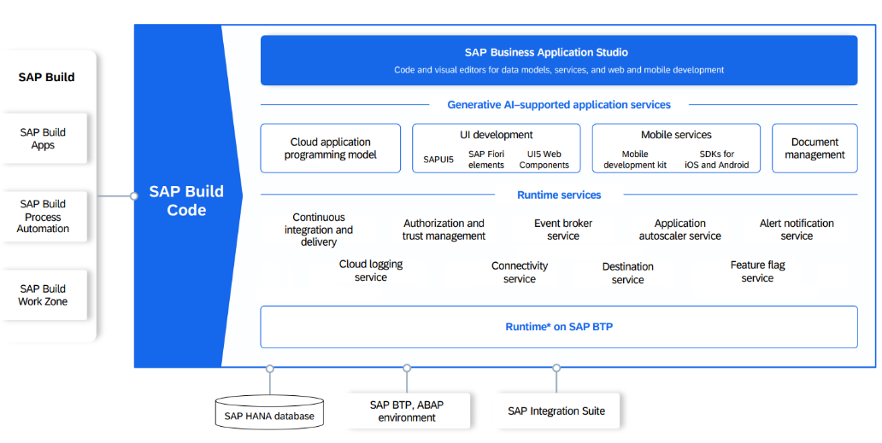
SAP Build Code Features
01
Supercharged development with generative AI
02
Enhance fusion development
03
Tailored for SAP development
04
Combines SAP BAS with SDKs on BTP
05
Automatic generation of app code , data models and services with sample data
06
Access via SAP Build lobby

Slide 7
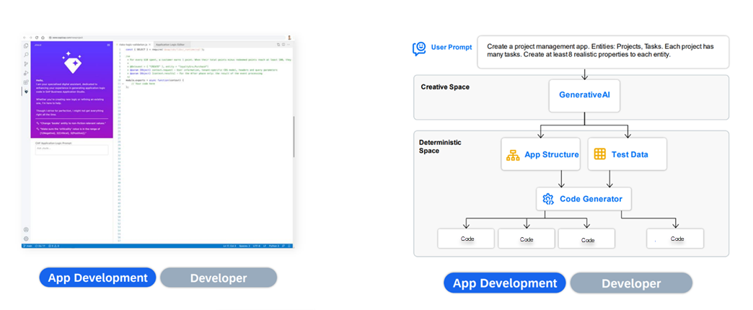
SAP Build Code – with Joule
Generative AI-based code development with Joule copilot, optimized for Java and JavaScript application development.
Notes:
What to expect from Joule

Slide 8
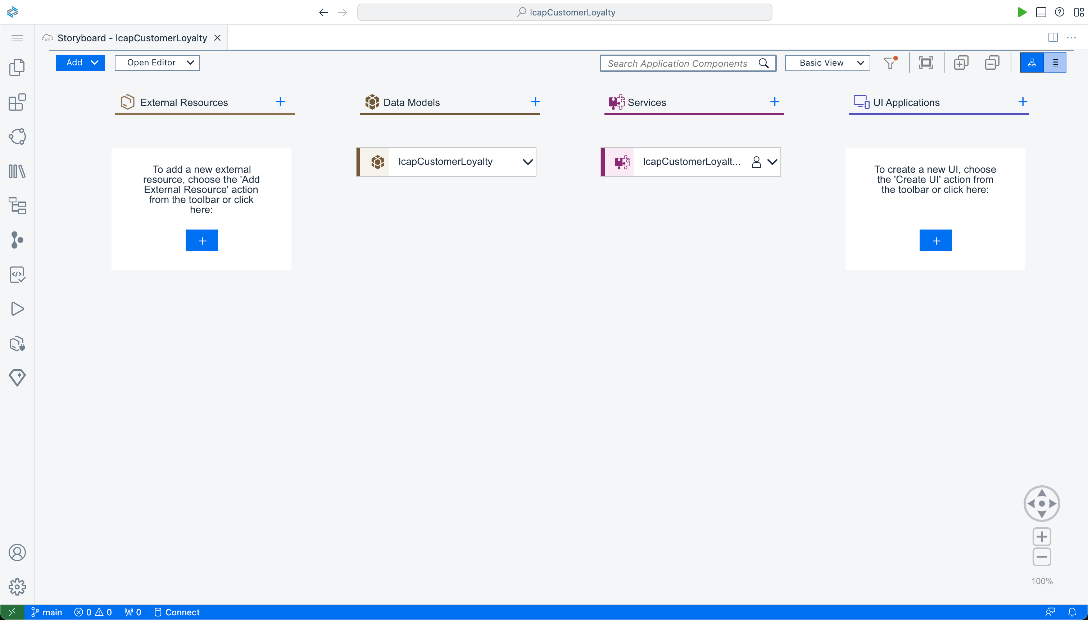
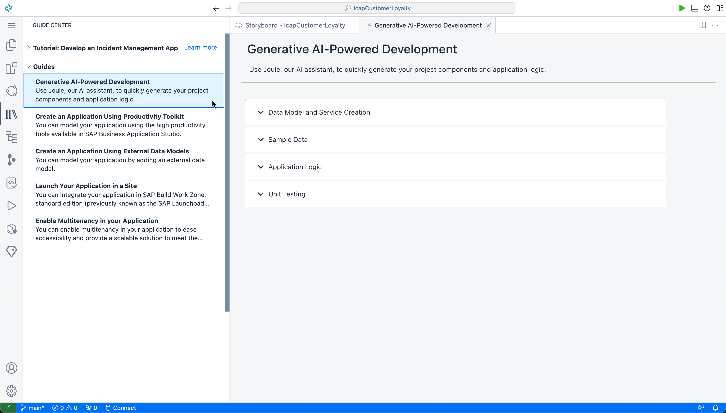
SAP Build Code
Creating a new project from SAP Build Code lobby : BAS launched with the Storyboard viewer opened
Notes:
What to expect from Joule

Slide 9
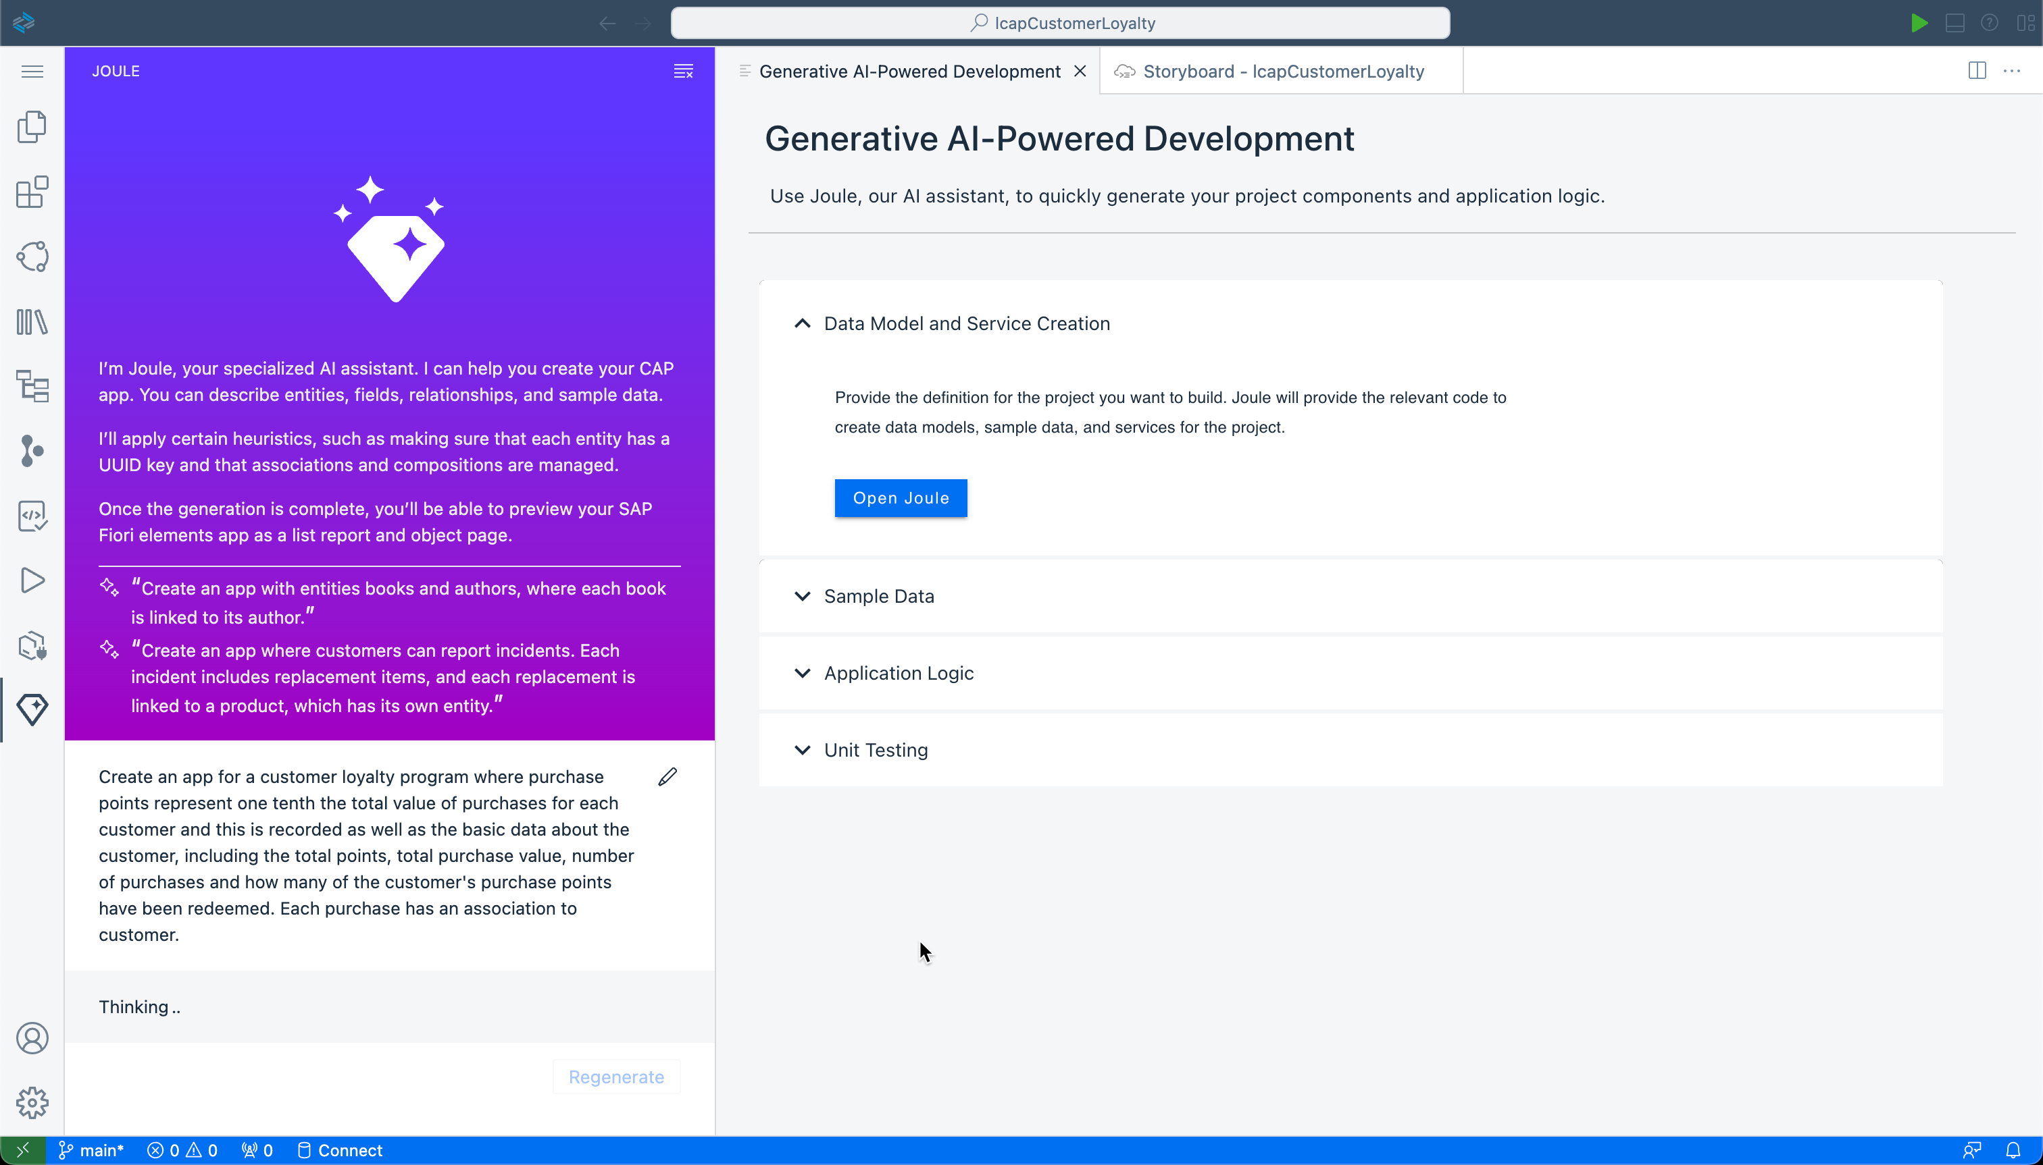
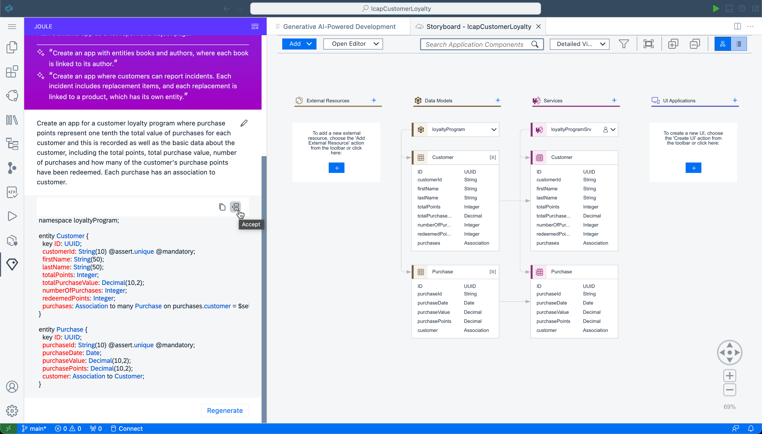
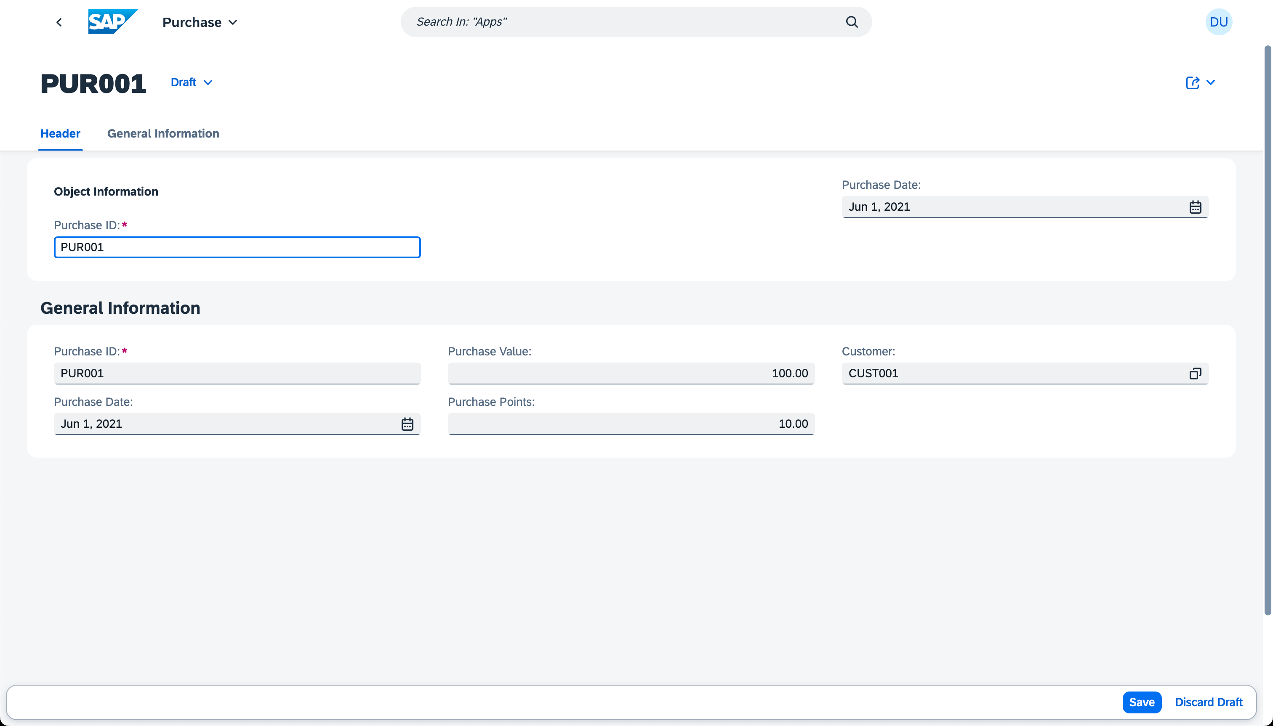
SAP Build Code
Data Model and Service Creation
Notes:
What to expect from Joule

Slide 10
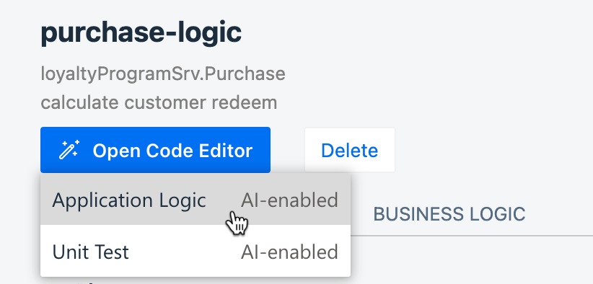
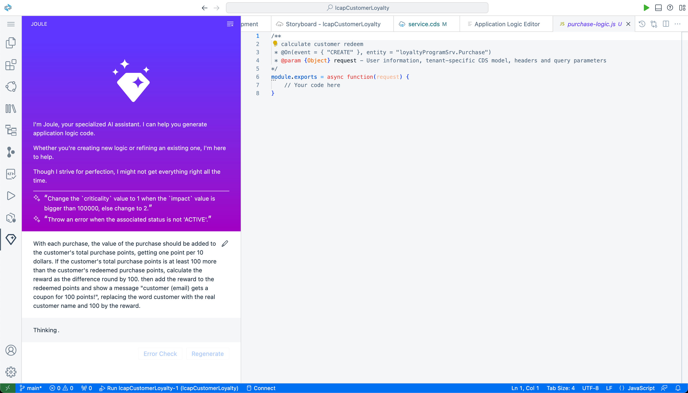
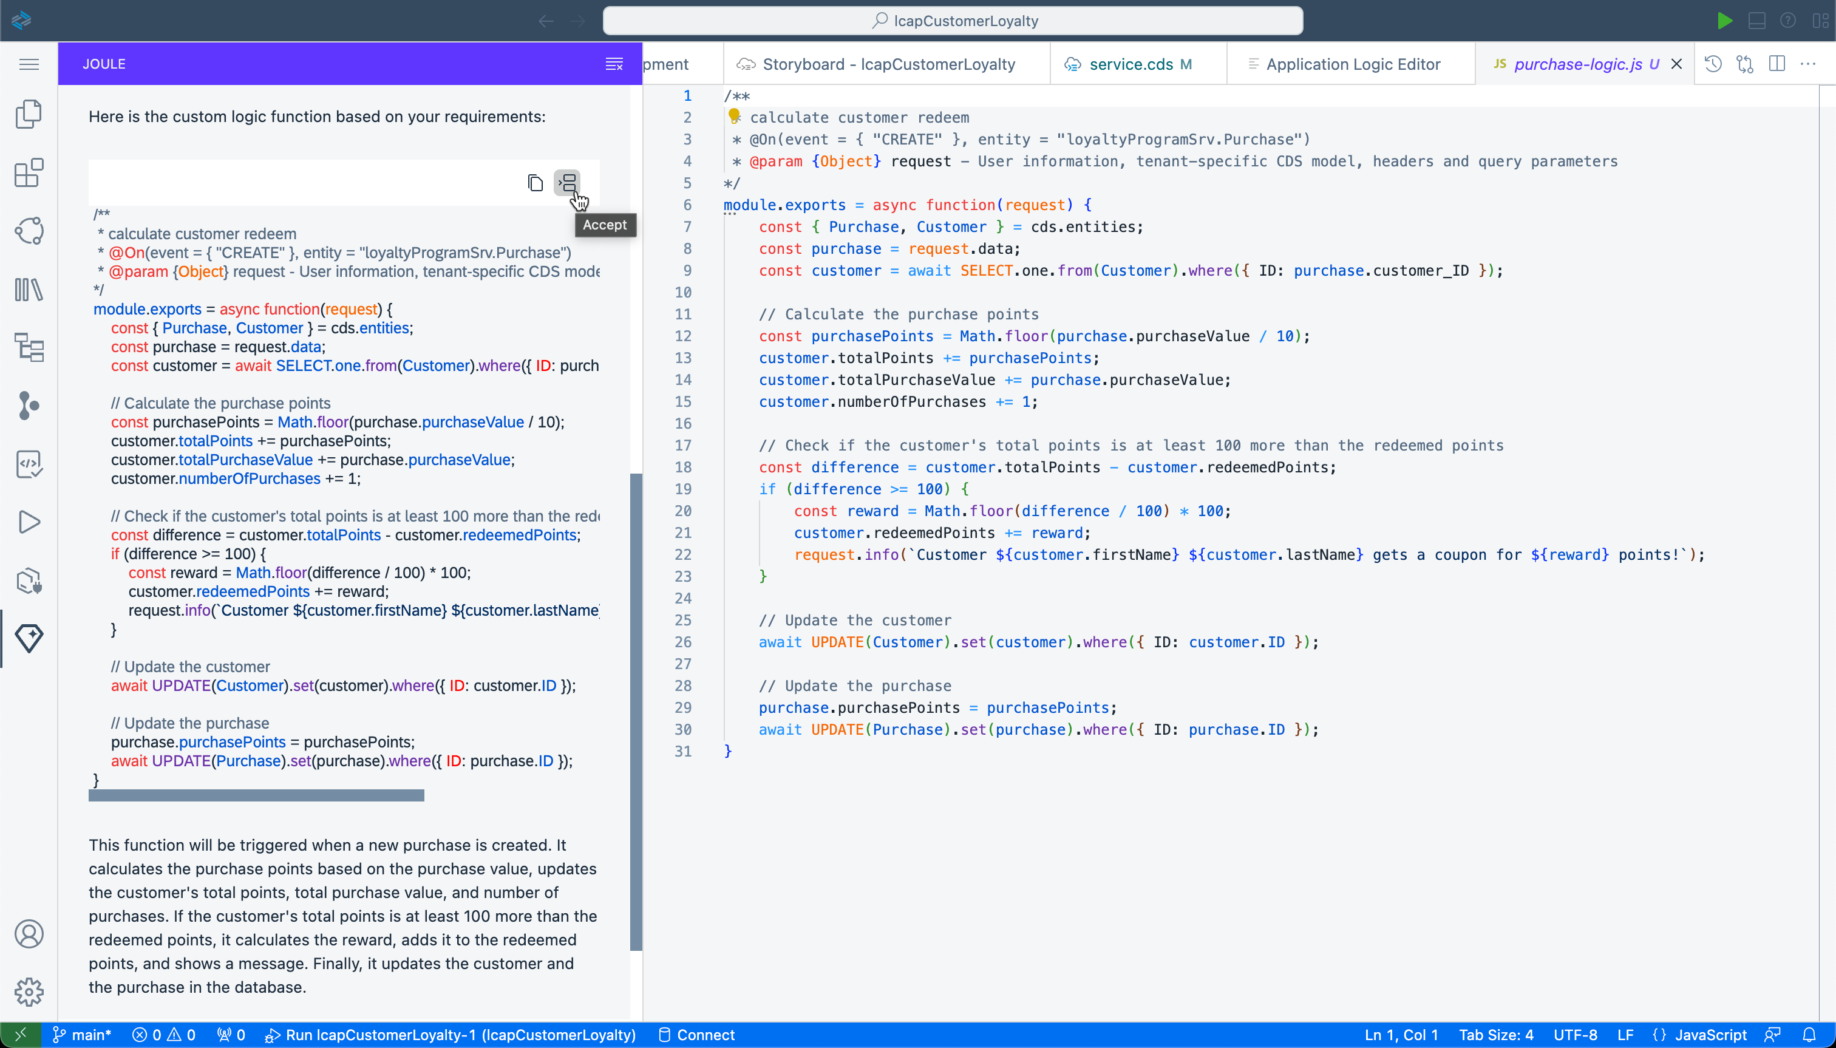
SAP Build Code
Application Logic Generation
Notes:
What to expect from Joule

